Slide 1
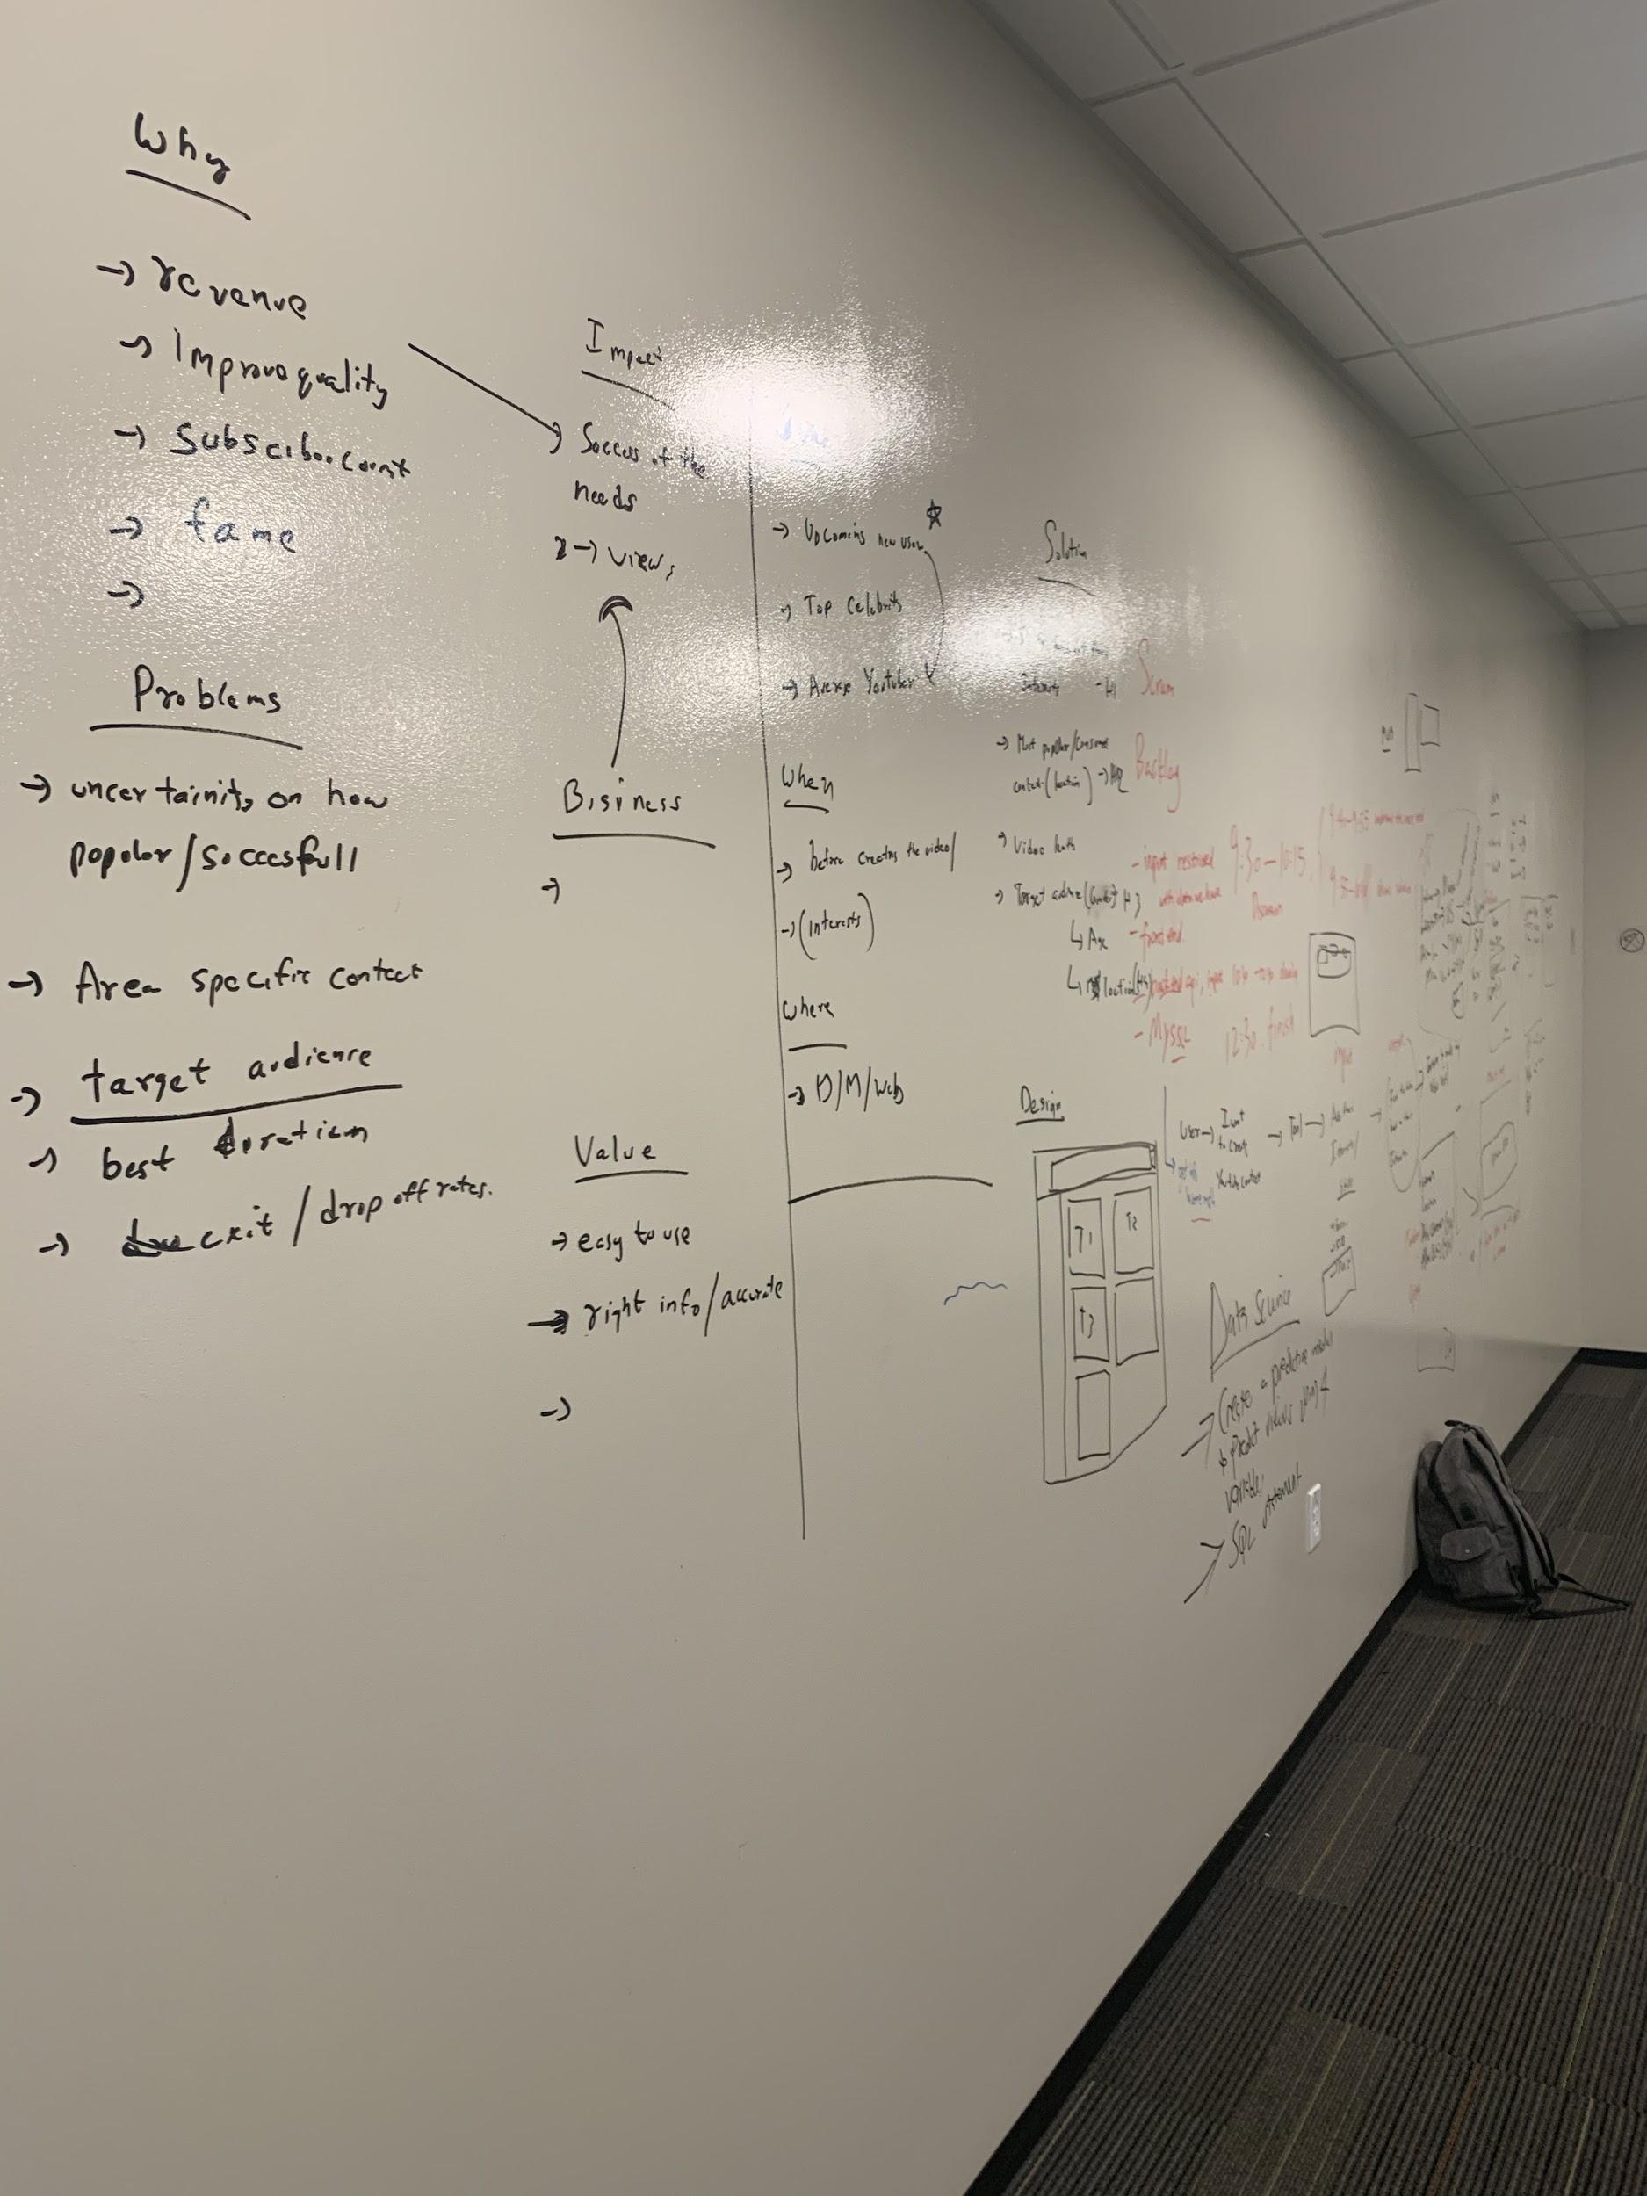
Goal
PERSONA
Design and develop a tool that forecasts how popular a YouTube video will be. An YouTuber will use this feature to plan the topic of their next or first video.
Problem
User is uncertain on how a video gets popular or successful?
User is unaware of the reasons why a youtube consumer exits or drops off from the video.
User don’t know the characteristics of a successful video.
Needs
User want to know to what kind of content is successful.
Making right choices can get them more views and subscribers.
User want to set the characteristics of the video.
Value
Easy to use
Accurate information.
Success to the user
Team-8

Slide 2
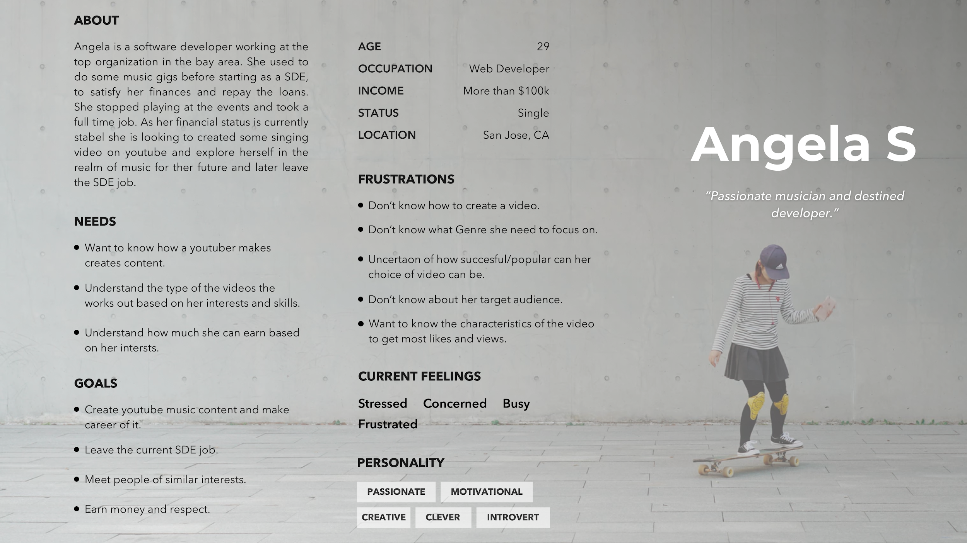
PERSONA

Slide 3
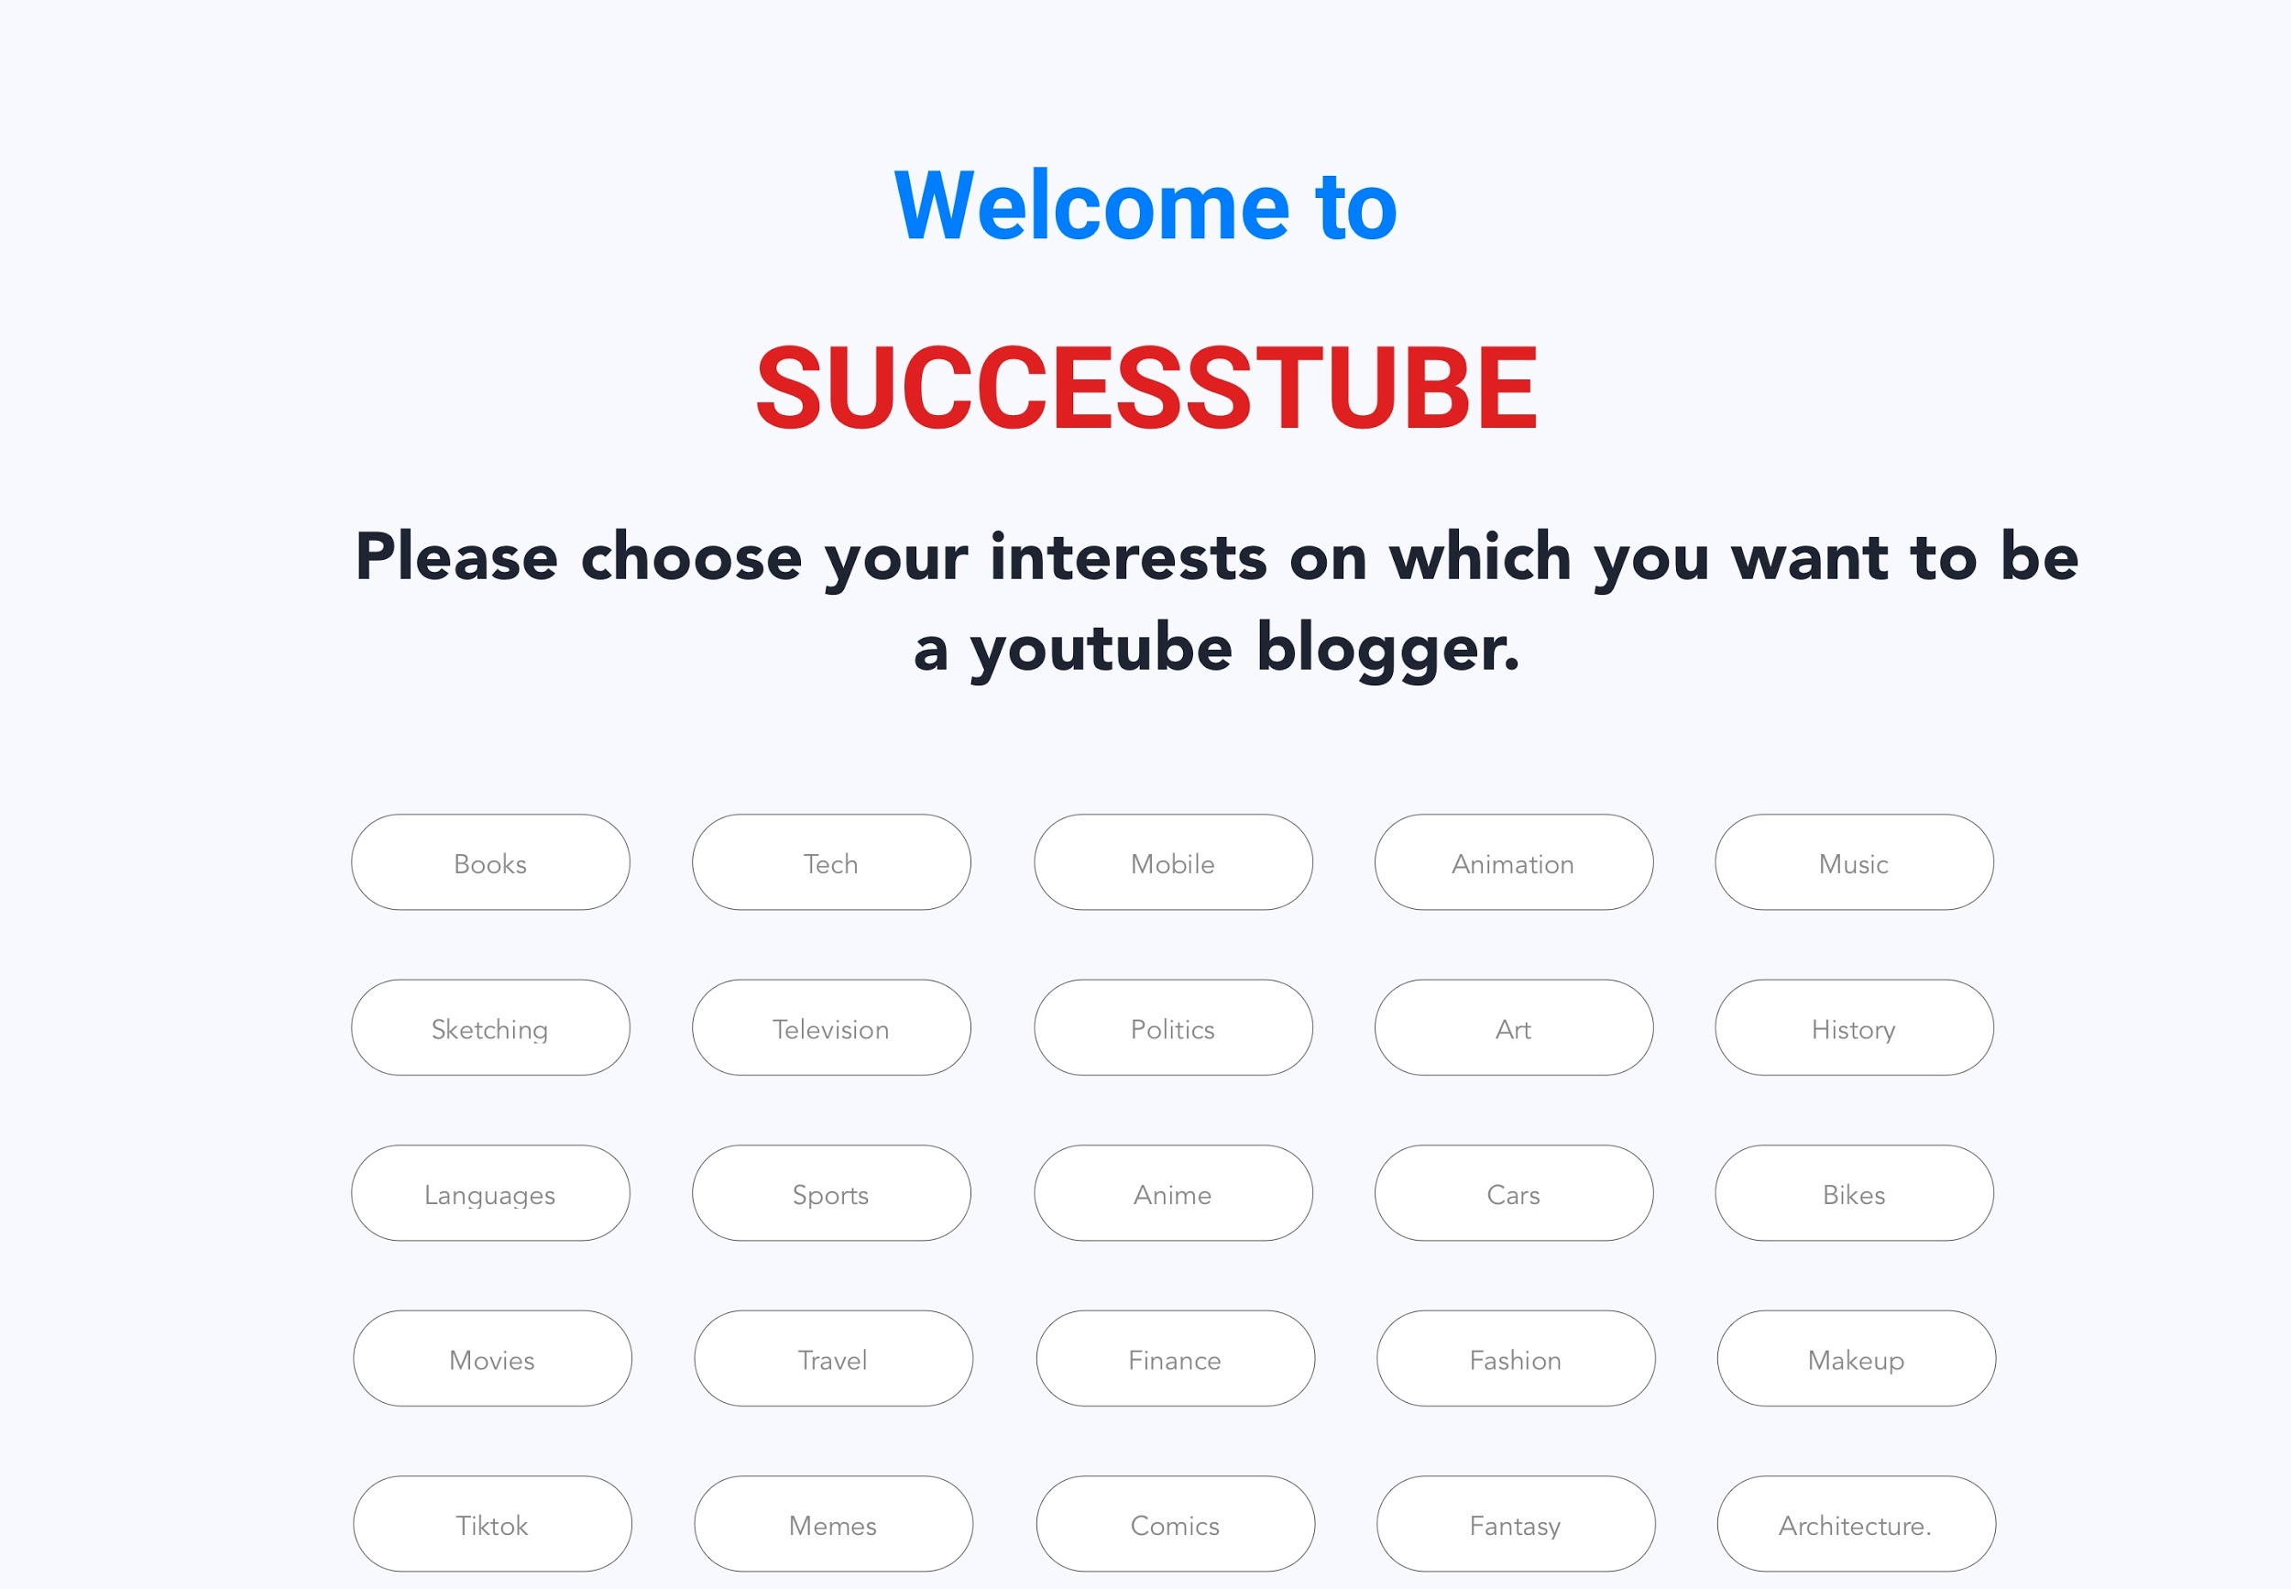
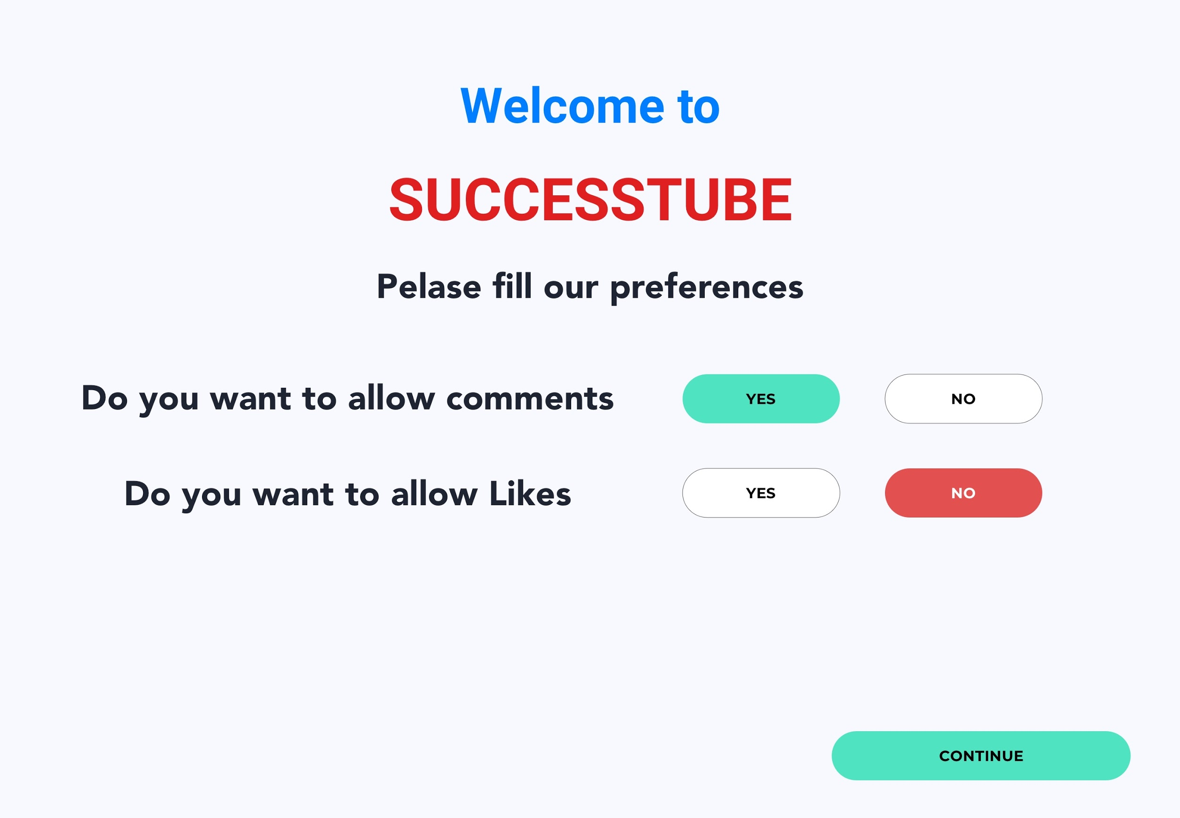
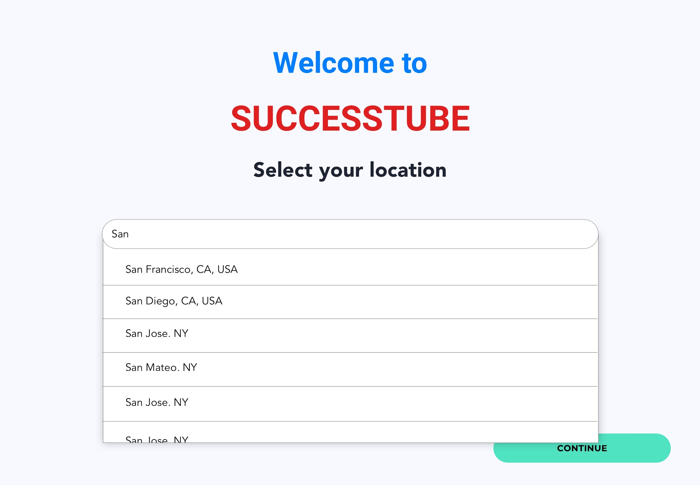
USER STORIES
PROTOTYPES
As a new youtuber I want to find the number of views I can get based on my video choice, so that I can create a successful video.
As a new youtuber I want to find the most viewed/ successful topic, so that I can start my youtube channel.
As a new youtuber I want to find the most viewed content, so that I can choose the category/genre of my video.
As a new youtuber I want to find the most viewed/ succesful content duration, so that I can define my video duration.
As a new youtuber I want to find the viewers characteristics, so that I can define the topic bases on the audience.
User Interests
User Preferences
Skip
Skip
User Location
Skip

Slide 4
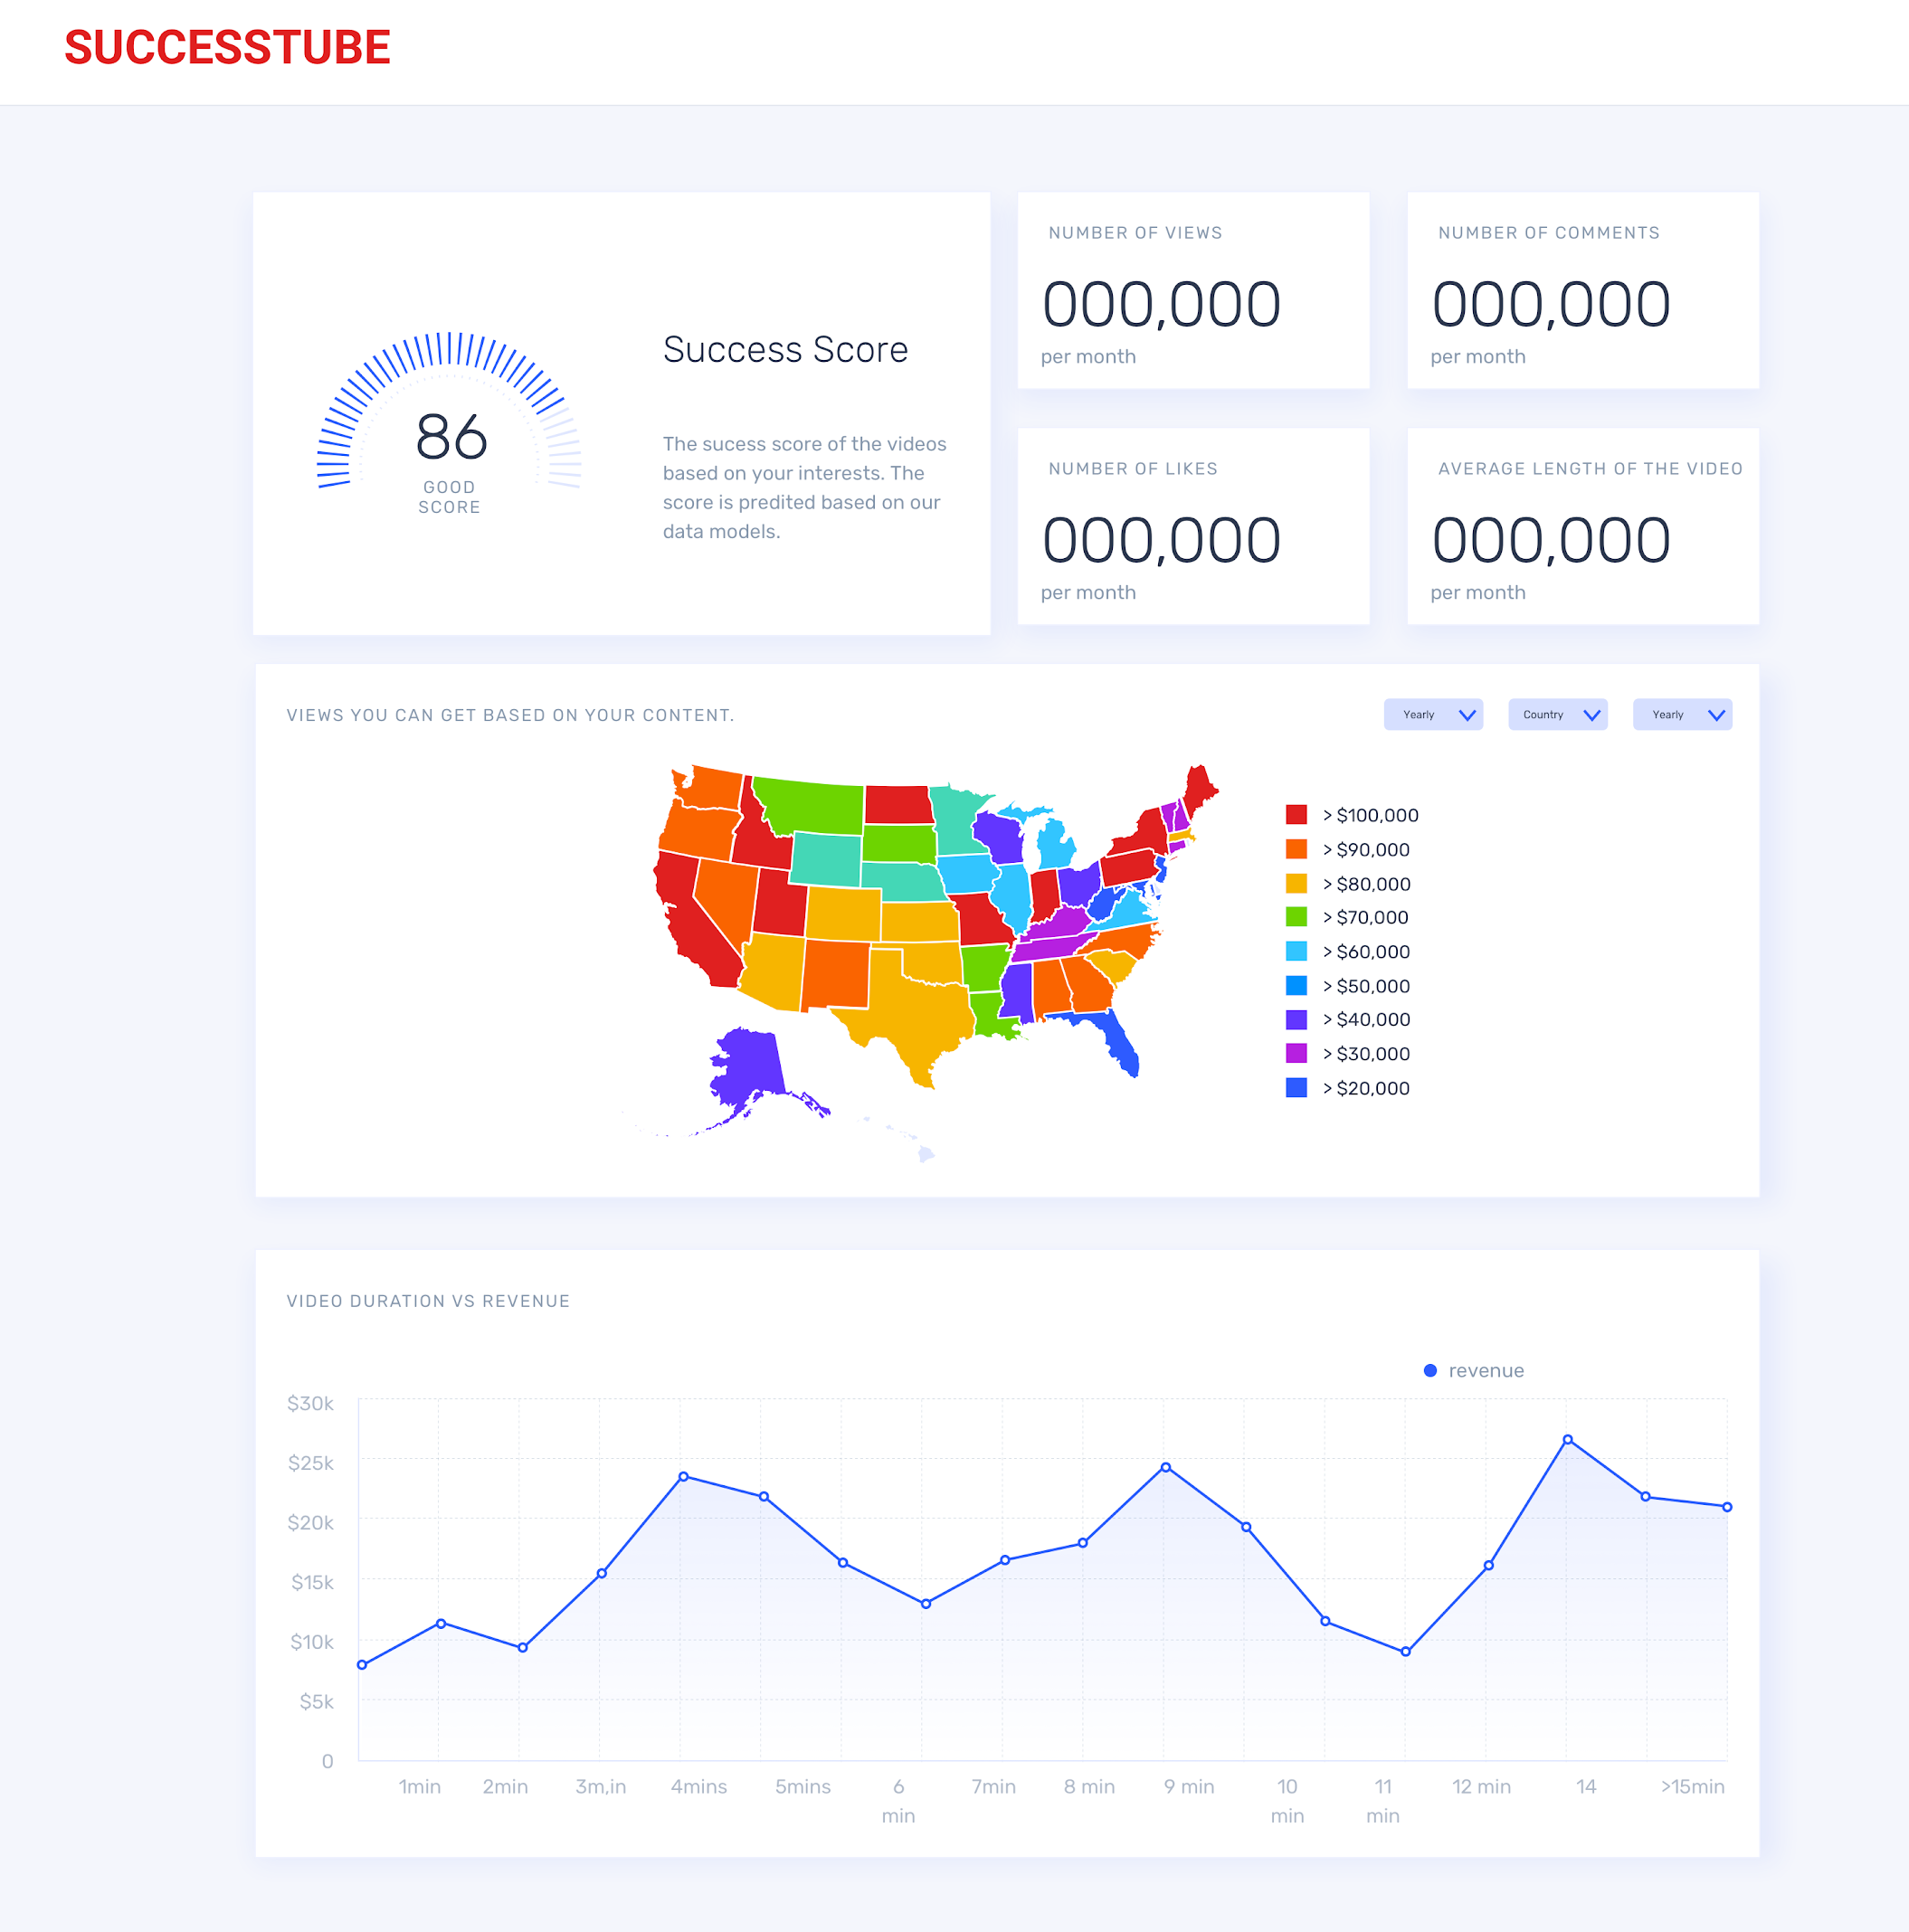
PROTOTYPES
FUTURE
Dashboard/ Output
Looking into the data available and build complex backend data models for better suggestions/success scores.
Interview user to understand what they need to define their video content and its characteristics.
Having longer and frequent whiteborading sessions to understand the data and how it can be used.
Improve the UX and UI of the prototype and test it with the user.
Create more user stories and flow.
Success Metrics
User exit and drop of rate.
User surveys and customer experience surveys. (data vs reality)
Time taken to find the information

